Slide 1
Admin Dashboard Analysis
Team Details
D.Reshwanth (20EG105516)
S.Santosh (20EG105560)
M.Uday Kiran (20EG105733)
Project Supervisor
Mrs. S. Bhagya Rekha
(Assistant Professor, Department of CSE, Anurag University)

Slide 2
Introduction
Admin dashboards offer a quick snapshot of key metrics and performance indicators. Utilizing data visualizations and real-time updates, decision-makers gain actionable insights. Customization and data integration provide a comprehensive view, while interactivity enhances decision support. Crucially, robust security measures safeguard sensitive information on these dashboards.
Purpose:
Central hub for monitoring and managing organizational operations.
Data Visualization:
Visual representation of key metrics using charts and graphs.
KPIs:
Focus on Key Performance Indicators for quick assessment.
Real-time Monitoring:
Provides real-time updates for proactive decision-making.
Customization:
Customizable dashboards to meet user-specific needs.
Interactivity:
Interactive features for detailed data exploration.
Data Integration:
Aggregates data from various sources for a comprehensive view.
Decision Support:
Offers actionable insights for informed decision-making.
Security:
Robust security measures to protect sensitive information.

Slide 3
Problem Statement
The current organizational setup faces challenges due to the absence of an efficient Admin Dashboard, leading to issues like data overload, inefficient user management, limited analytics, and poor system monitoring. These challenges impact compliance, security, customization, and integration. Addressing these issues is crucial for enhancing operational efficiency, enabling better decision-making, and ensuring a secure organizational environment. Implementing a comprehensive Admin Dashboard is essential for streamlined management and monitoring, providing actionable insights to administrators.
Disadvantages:
Overreliance on Metrics: Narrow focus, neglecting contextual factors; decisions may lack nuance.
Data Overload: Excessive metrics overwhelm users, causing confusion and decision paralysis.
Security Concerns: Displaying sensitive data poses risks, potentially leading to breaches and consequences.

Slide 4
Proposed Method
The proposed Admin Dashboard Analysis method is a systematic and data-driven approach to optimize system performance. It initiates with comprehensive data collection from diverse sources like website analytics, user interactions, and sales records. Key Performance Indicators (KPIs) are meticulously identified, aligning with specific business goals to measure success. A user-friendly dashboard is designed to visualize and consolidate real-time data, promoting quick and informed decision-making.
The method incorporates user segmentation, allowing for a detailed analysis of different user groups and their interactions. Predictive analytics models are integrated, enabling administrators to forecast trends and potential issues. Customizable reporting ensures flexibility, empowering administrators to focus on specific metrics critical to their objectives.
This dynamic method not only empowers administrators with actionable insights but also creates a feedback loop for sustained refinement, ensuring the Admin Dashboard remains a powerful and adaptable tool for monitoring, analyzing, and enhancing system performance.

Slide 5
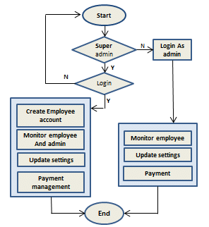
Proposed Method Illustration
Define Objectives and Stakeholders:
Identify goals and key stakeholders for the admin dashboard.
Data Collection and Integration:
Gather and integrate relevant data sources for analysis.
Dashboard Design and Development:
Design and develop the dashboard layout, incorporating interactive features.
Iterative Testing and Feedback:
Create prototypes, gather feedback, and iterate on design.
Implementation and Training:
Develop and deploy the dashboard, providing training and documentation for users.
Monitor and Maintain:
Monitor dashboard performance and user feedback, making updates as necessary.
By following these steps, you can efficiently create an admin dashboard that meets the needs of administrators and supports data-driven decision-making.

Slide 6
Experiment Environment
Programming Language: Html, CSS, Javascript (MERN)
Working Environment: VSCODE
Node Version: 21.6.1
MongoDB Version: MongoDB 7.0
ReactJS Version: 18.1.0
Express Version 4.18.2
Packages: npm, yarn
Libraries React, JQuery

Slide 7
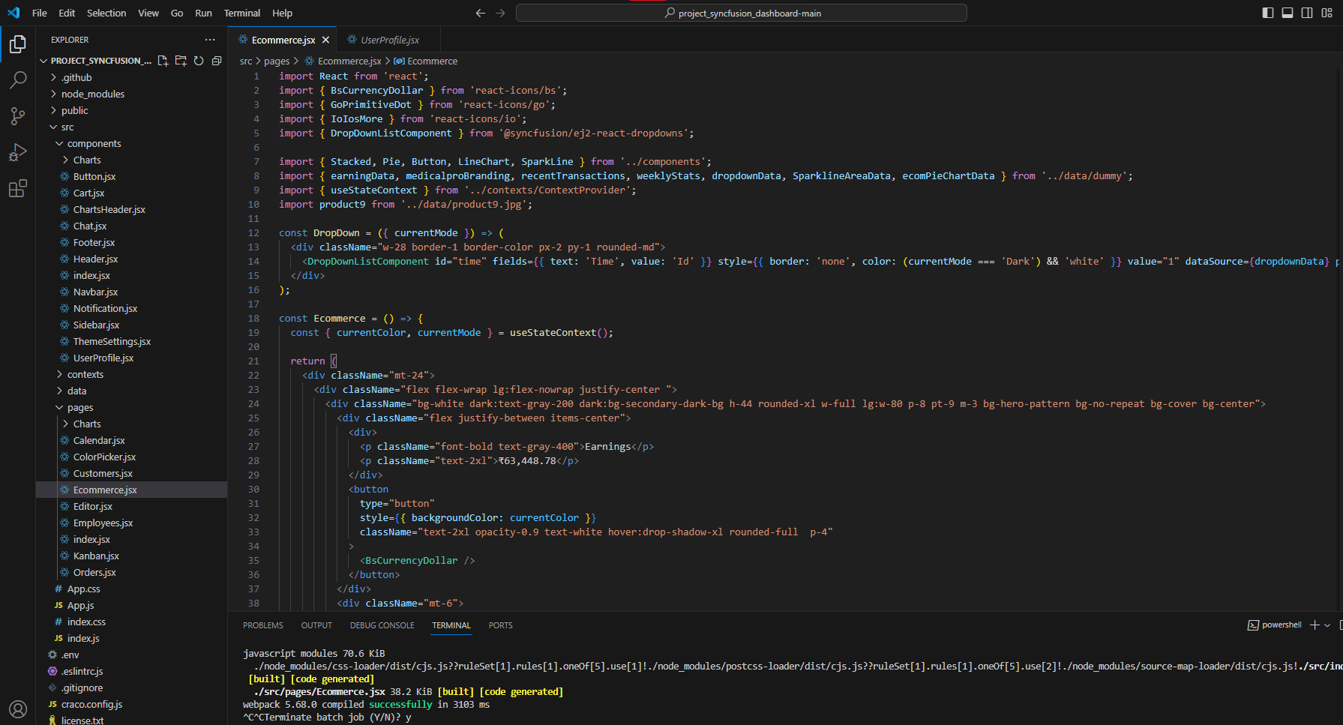
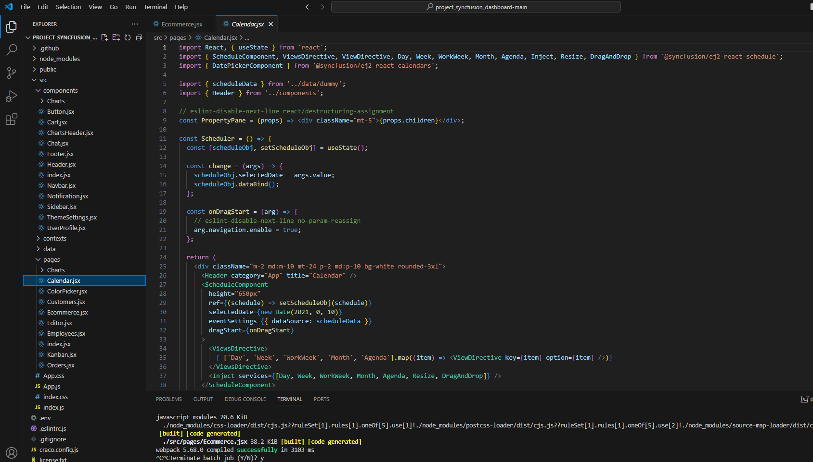
Experiment Screen shorts

Slide 8
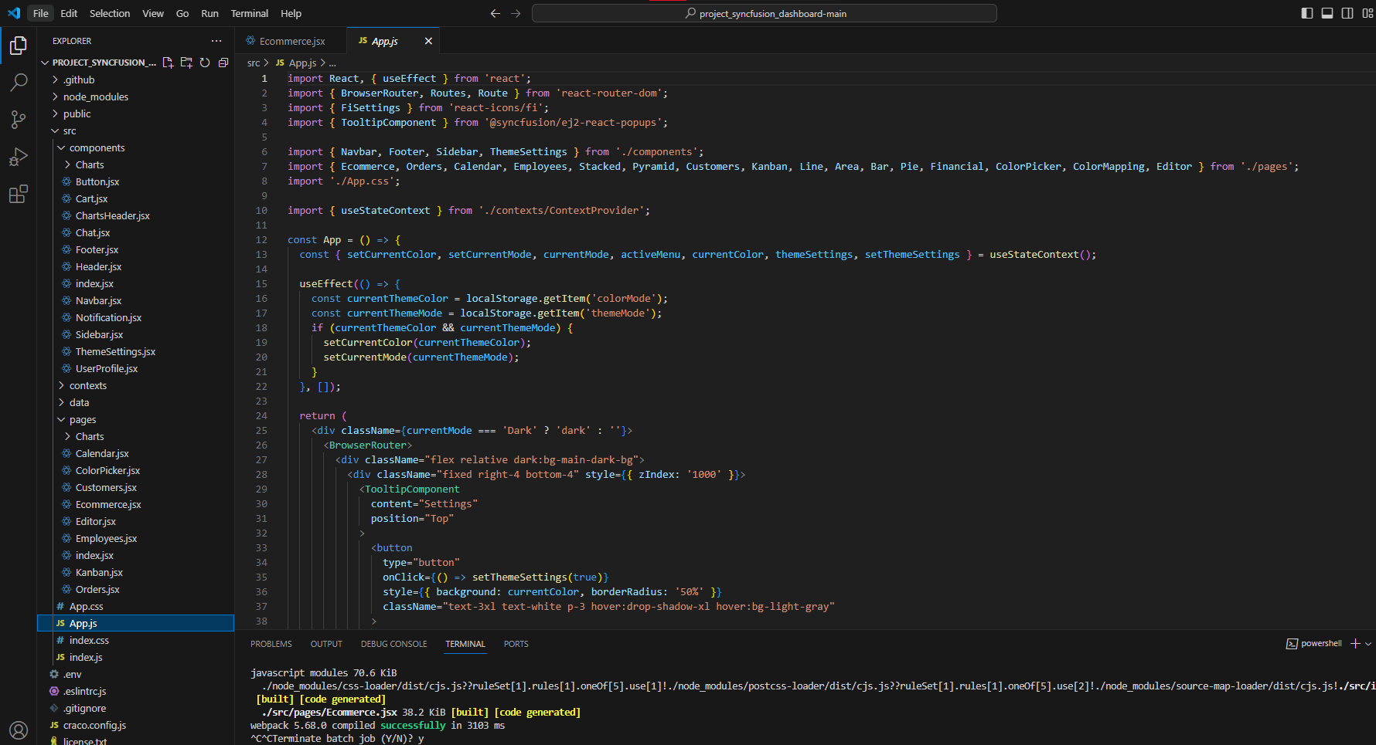
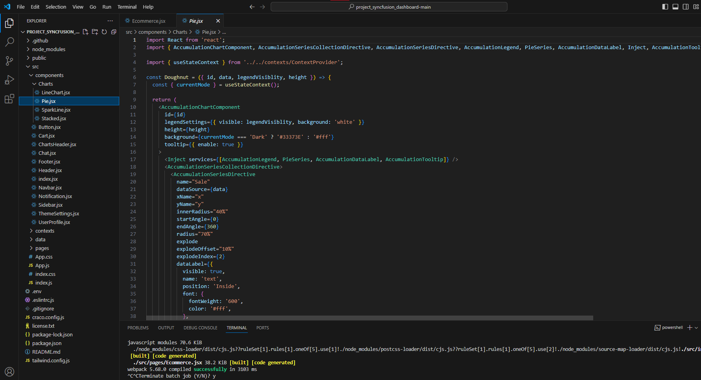
Experiment Screen shorts

Slide 9
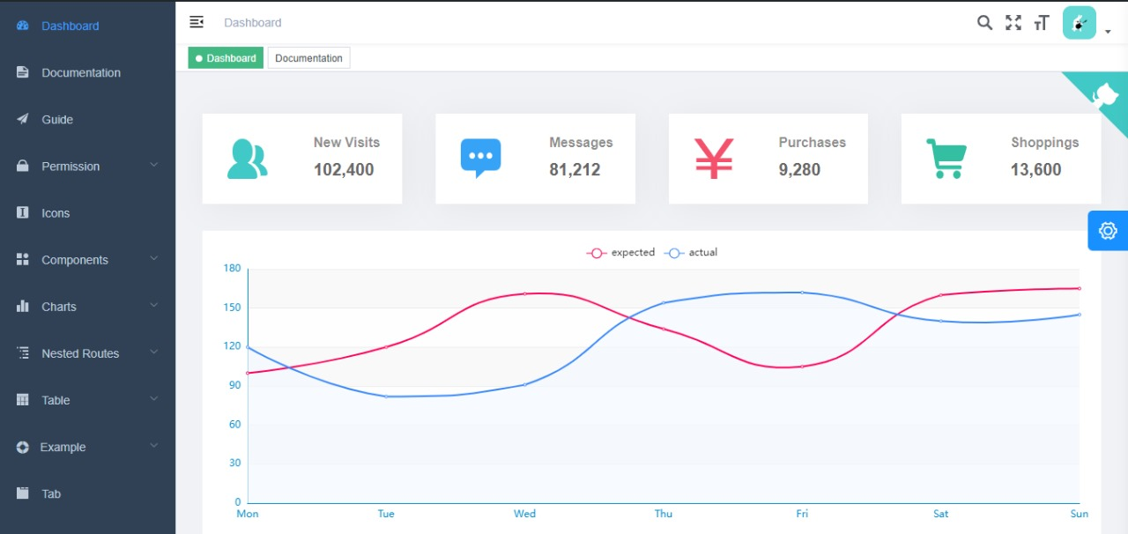
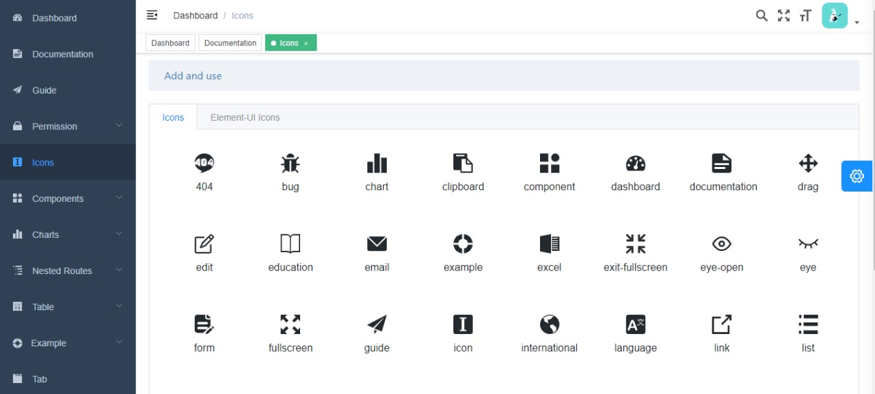
Experiment Results

Slide 10
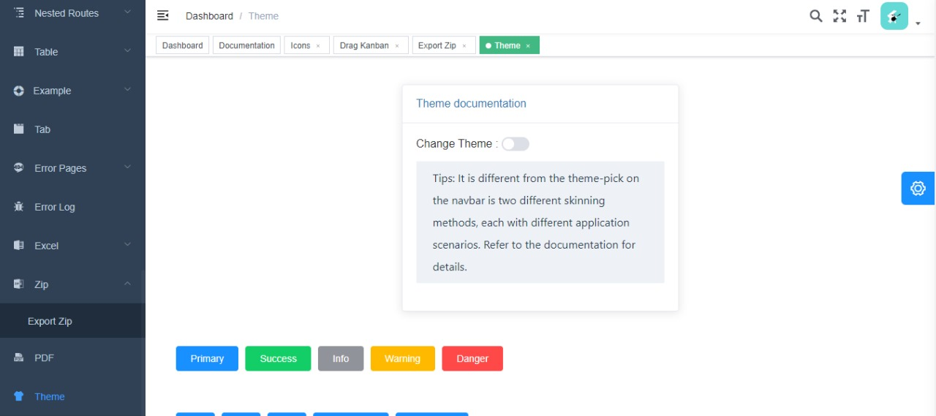
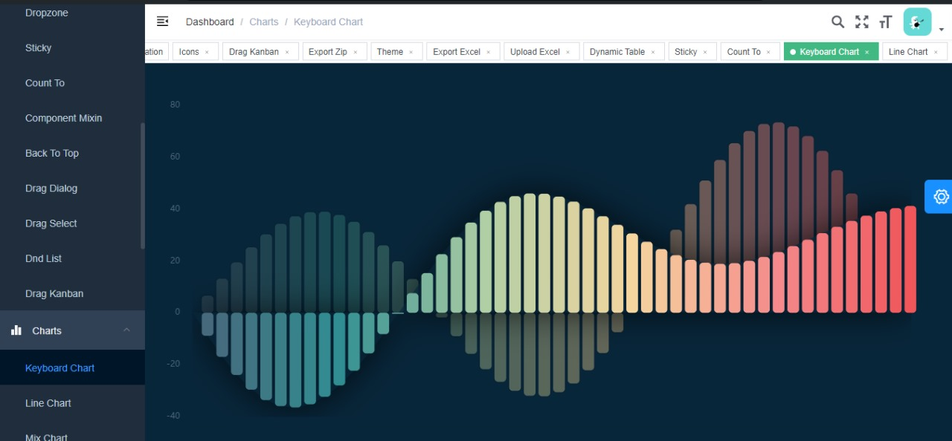
Experiment Results

Slide 11
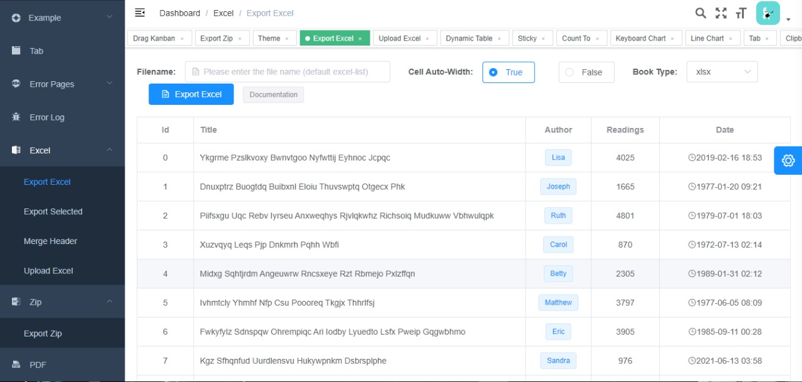
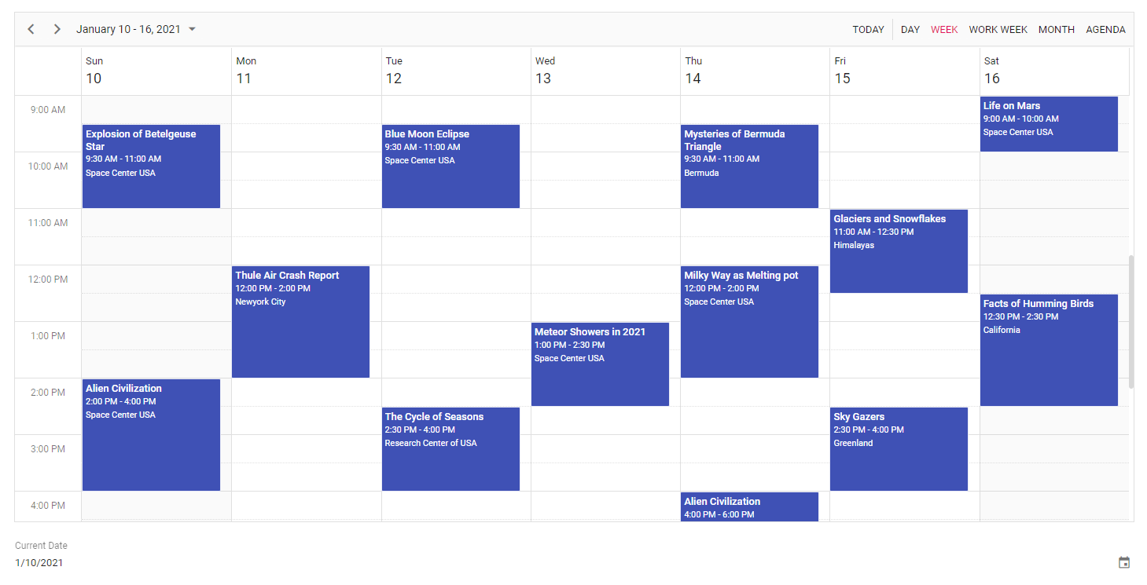
Experiment Results

Slide 12
Findings
Creating a robust and efficient admin dashboard is crucial for managing and monitoring various aspects of a system or organization. In conclusion, the admin dashboard serves as a centralized hub, providing real-time insights, facilitating data-driven decision-making, and enhancing overall operational efficiency. By incorporating user-friendly interfaces, customizable features, and comprehensive analytics, the admin dashboard empowers administrators to streamline workflows, identify trends, and address issues proactively. As technology continues to evolve, investing in the development and optimization of an admin dashboard remains paramount for staying competitive and ensuring organizational success in today's dynamic landscape.

Slide 13
Justification
Admin dashboard analysis offers essential benefits for organizational management:
Real-time Insights: Provides immediate access to crucial data for monitoring operations and identifying trends.
Informed Decision Making: Enables administrators to base decisions on factual evidence and trends, enhancing accuracy and outcomes.
Performance Evaluation: Tracks progress towards goals, allowing for timely adjustments to strategies and resource allocations.
Resource Optimization: Identifies opportunities to enhance productivity and reduce costs through efficient resource allocation.
Transparency and Accountability: Promotes a culture of transparency and fosters accountability among stakeholders by providing access to relevant performance metrics.
Risk Management: Proactively identifies potential risks and opportunities for growth or improvement, allowing for timely mitigation actions.
In essence, admin dashboard analysis facilitates informed decision-making, enhances operational efficiency, and mitigates risks, contributing to organizational success.

